Slide 1
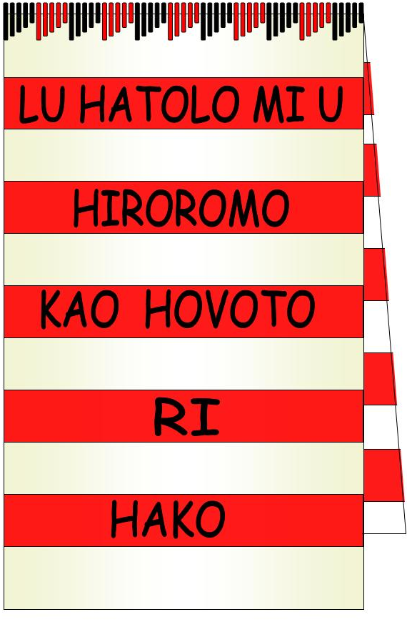
Hako Women’s Collective
HWC is an umbrella body for all women in the Haku Constituency, Buka Island.
Our Haku language is one of 3 main languages in Buka within the Autonomous Region of Bougainville (ARB).
Open membership and inclusive policies govern our ‘sisterhood’.

Slide 2
WHY DO WE EXIST?
HWC was formed in June 2006 by 650 Hako women in response to the critical needs of society- Haku awaits reconciliation from post conflict divisions and unaddressed war related violence and death.
We are all ordinary village women but many of us were displaced from careers by the war, so we have collected our teaching, nursing, secretarial skills etc and use these as freewill offerings to our initiatives in serving our community needs.

Slide 3
Hako Women’s Collective (HWC) Vision Statement (MEHE)
LU HATOLO MUI
HIROROMO KAO HOVOTO RI HAKO
“In the spirit of love and true sisterhood
we (the women of HWC) are called to build a secure and just environment within our families and communities and to create an integrated sustainable development that will establish a better future for our children and children’s children”

Slide 4
HOW DO WE OPERATE?

Slide 5
HWC Mission Statement (TUKUI)
AGA UKAO RI HAKO KE HIHI TAGUHU, HIHIATUTS, BATE HATAPAHANIGA E NUGU A HAN I TAGAGA
“In response to the current situation in our community, we the women of Hako are committed to work together, help each other, teach and train our people to build a safe, secure, just and peaceful society as stated in our vision.”

Slide 6
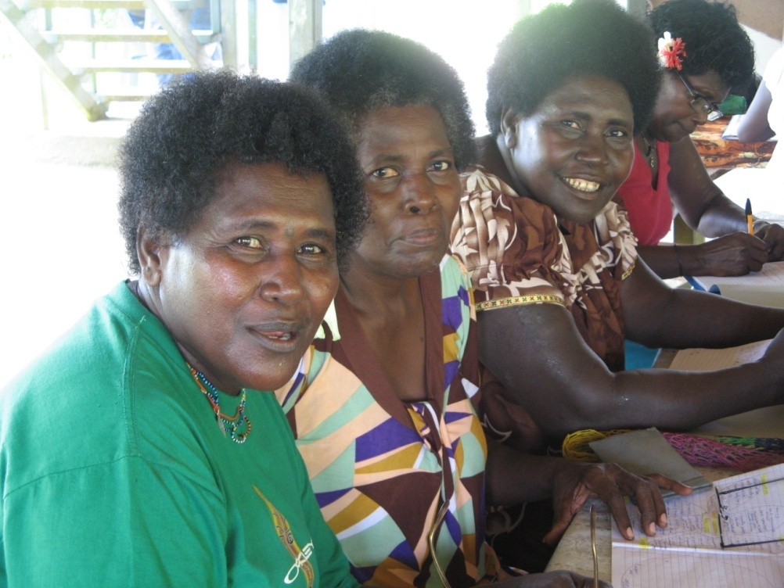
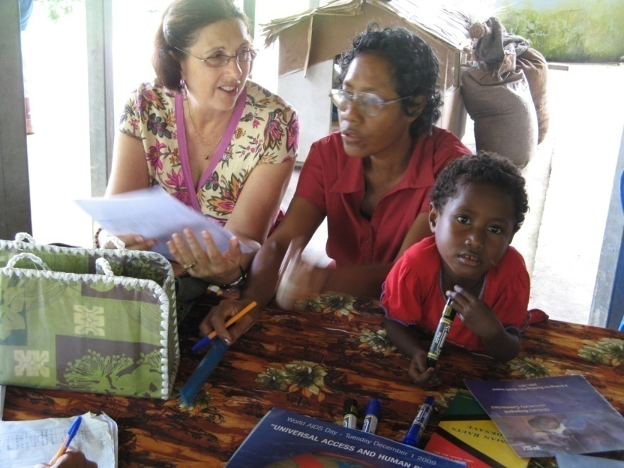
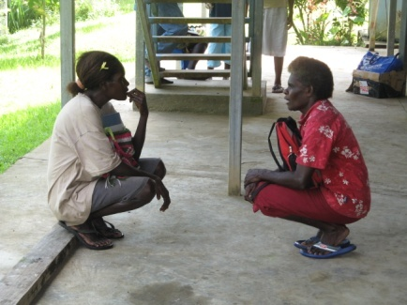
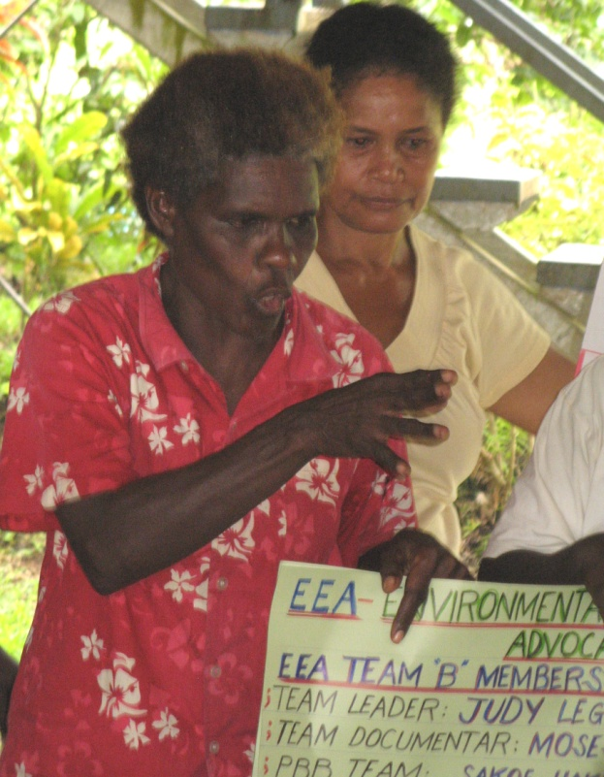
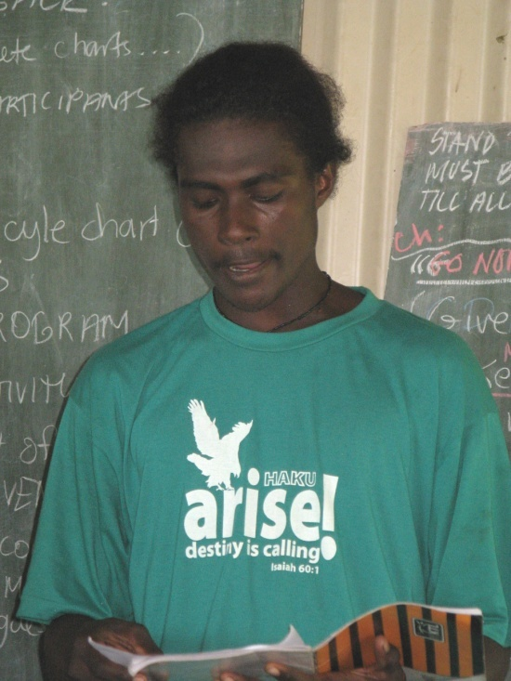
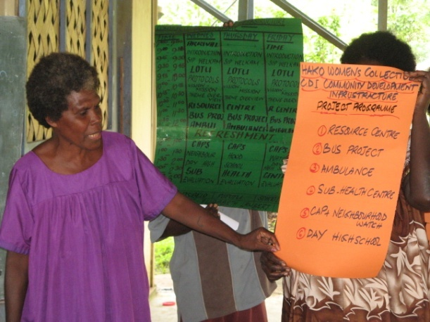
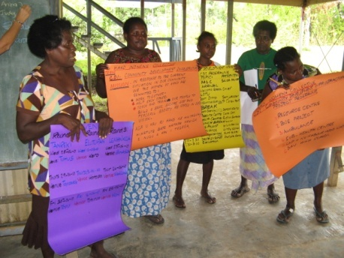
HWC empowering leaders

Slide 7
Our home base: a former tyre repair service is being transformed into our HWC Resource Centre with a front meeting area, a back deck and three rooms: Library, Project Office, FASV rescue bedroom

Slide 8
VIPs at RC Official Opening 26th June 2016

Slide 9
Our meeting area is small but well used in training, meetings, in services, as a reading area for the library…below: President Dorcas Gano is training a team for the SPLP course

Slide 10
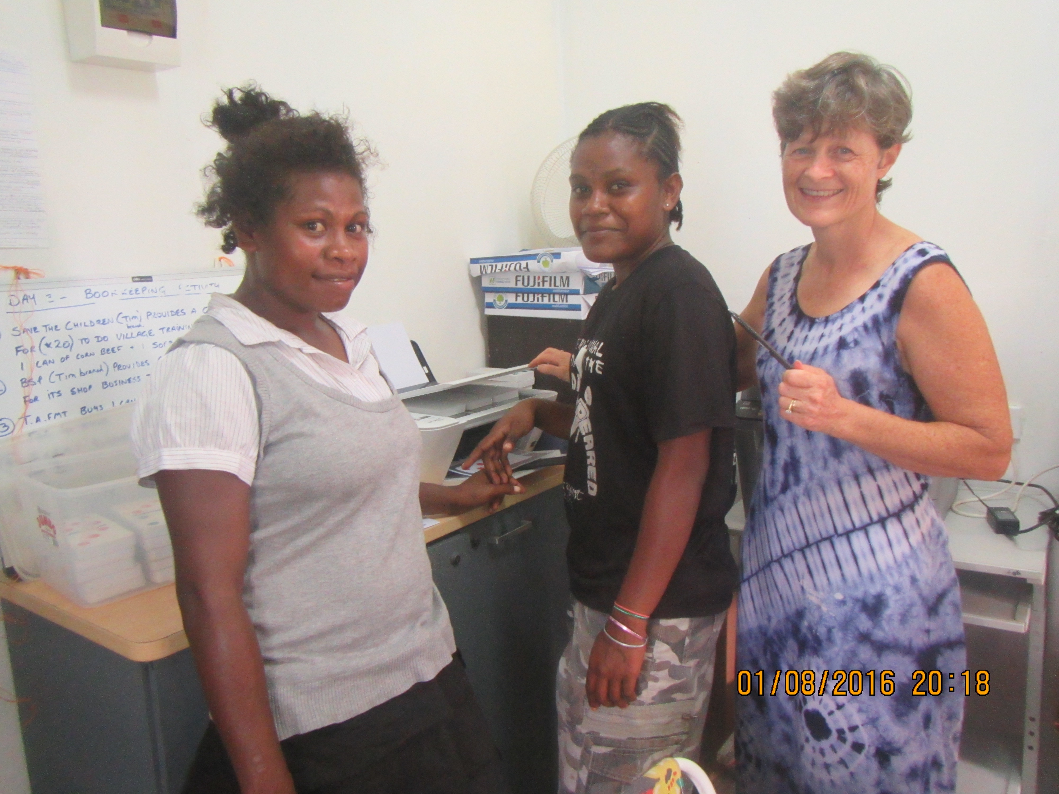
LHS: HWC Library & Office Manager Cindy Kehali with Haku Elementary Teachers during Book Week 2016 In Service RHS: Office volunteers Shandra & Bernadine with ABV trainer Fiona Carr in the Project Office

Slide 11
HWC PARTNERSHIPS
HWC has built partnerships between all the women’s groups, clans, churches & Haku community
HWC members serve in the Local Level Government COE
We have partnerships with Hako Youth – since holding YOUTH FORUM IN 2007
HWC supported Pacific Black Box (PBB) for youth media advocacy and formed a Hako Media Unit
Significant partnerships with Non Government Agencies include Nazareth Centre for Rehabilitation, Bougainville Women’s Federation, and Buka Hospital Family Support Centre, Family Sexual Violence Committee and Women Human Rights Defenders Network.
Together we have a new working partnership with UNICEF through the ABG Department of Community Development with on POSITIVE PARENTING (SPLP)
HWC over the years have formed partnerships with Government Departments to provide the logistics for them to come into Hako and help us deliver programs and assist Hako people. (Health, Law & Justice, Education, Com Dev etc, with: LPA, CEDAW, Cholera Awareness, Sports, DPI with Vudal Agriculture University, LLG, Disaster Office,
Combined Partners in advocacy on UN Resolution 1325 with UNIFEM, UNICEF, UNDP, OXFAM, CJLU, CARE Int. and numerous local Institutions for all forms of social services, health & education to meet the needs of the people of Bougainville.

Slide 12
SPLP with HWC/FSC/NRC/Com Dev/ UNICEF partners at Chabai August 2016

Slide 13
Hako Women’s Collective Policies
HWC has policies on:
Child Protection
Countering Bribery & Corruption
Countering Human Trafficking
Countering Terrorism
Code of Conduct

Slide 14
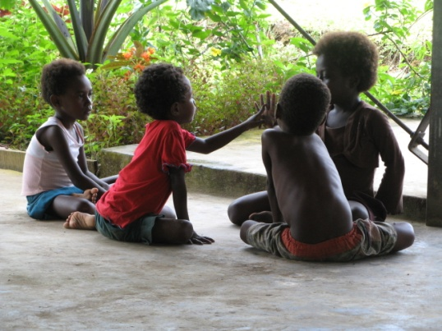
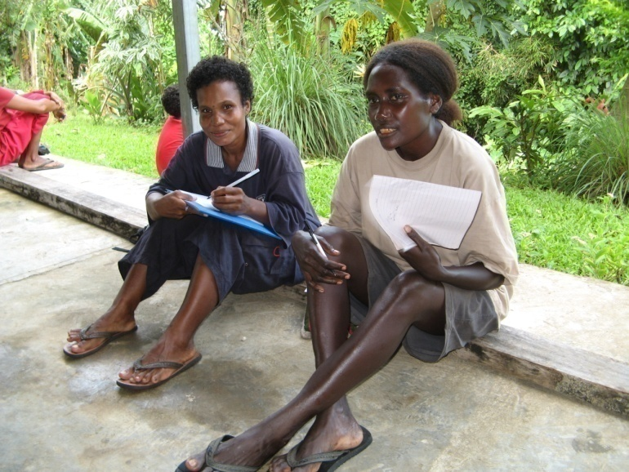
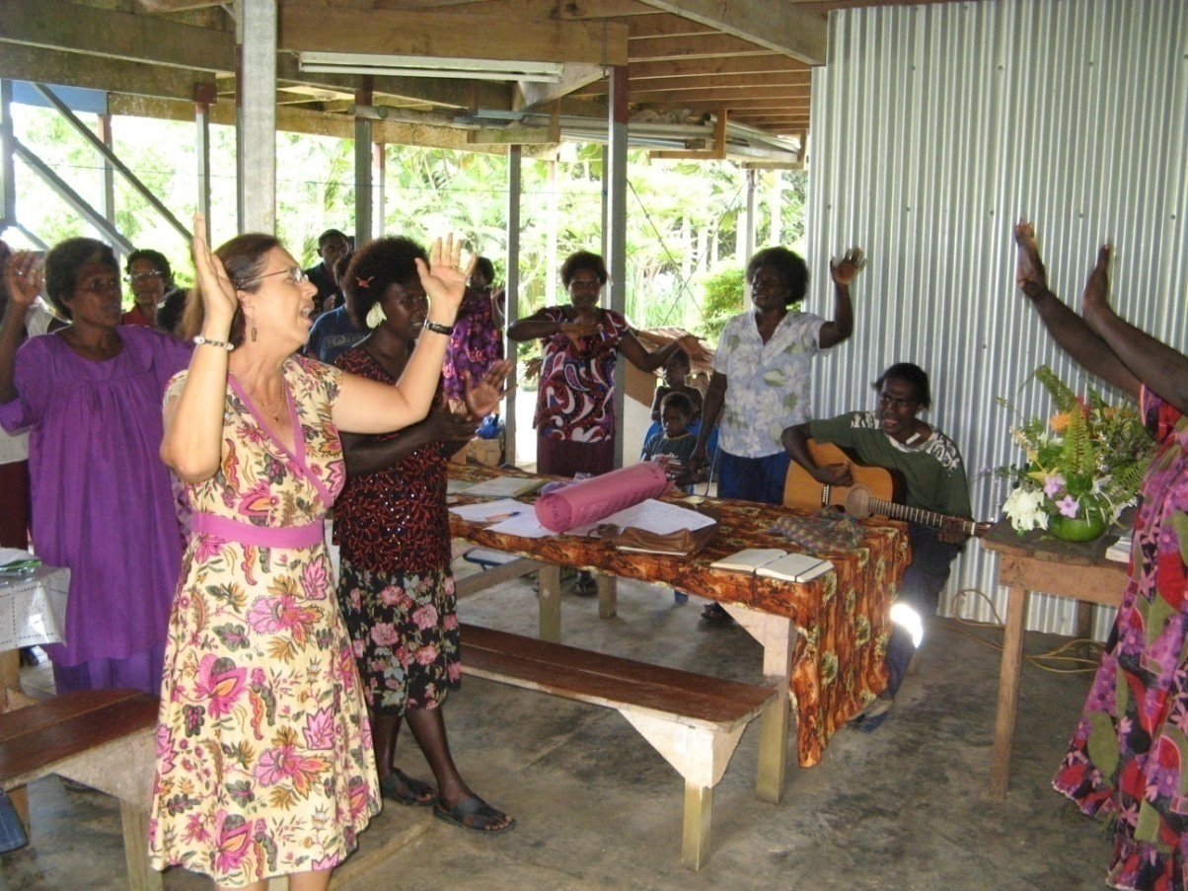
All HWC work is guided by Lotu (prayers), presentation of ideas, teamwork and inclusive of children, youth and men

Slide 15
Environmental Team at work

Slide 16
FOOD & WATER SECURITY IS CRITICAL for BUKA ISLAND & HAKU
SIZE- 50x17km of uplifted coral reef, volcanic Parkinson Range
AGRICULTURE is between sea level and 120m, mostly below 50m.
SOILS are generally fertile and well structured
No rivers in Hako – water sources- beach wells or tanks for villages relocated to clifftop ( sea level rise)
POPULATION in 2000 of 33,800 – highest birth rate is in Haku – now we have over 30, 000 in Haku alone!

Slide 17
PBB Youth Leaders support HWC as documenters

Slide 18
HWC PROJECT TEAMS & Program Areas .
Environmental Education and Advocacy (EEA)
Food Security, Rice & Nutrition
Land Management & Land Use,
Reef Care, Water & Sanitation,
Waste Management, OH&S
Disaster & Risk Management.
Art & Culture
Women’s integrated environmental advocacy (WIEA)
Family Planning & safe motherhood
FASV & WHRDN
Positive Parenting & SPLP
ENDVAC & Lukautim Pikinini Act
HIV AIDS and STD’s,
YOUTH & Life Clock, Drugs and alcohol)
Community Development and Infrastructure (CDI)
Resource Centre
Library & Education services
Office Services
Bus Service
Neighbourhood watch & L&J partners
Disability Services with Amenity Centre
‘Fail to plan= plan to fail’
Communication and leadership
Public speaking
Program Planning
Motivation, activity planning, skills transfer, ice breakers.
Program Logistics
Presentation preparation with ‘Team Times’
Individual Preparation of content, materials, venues etc for presentations
Documenting and Monitoring
Evaluation

Slide 19
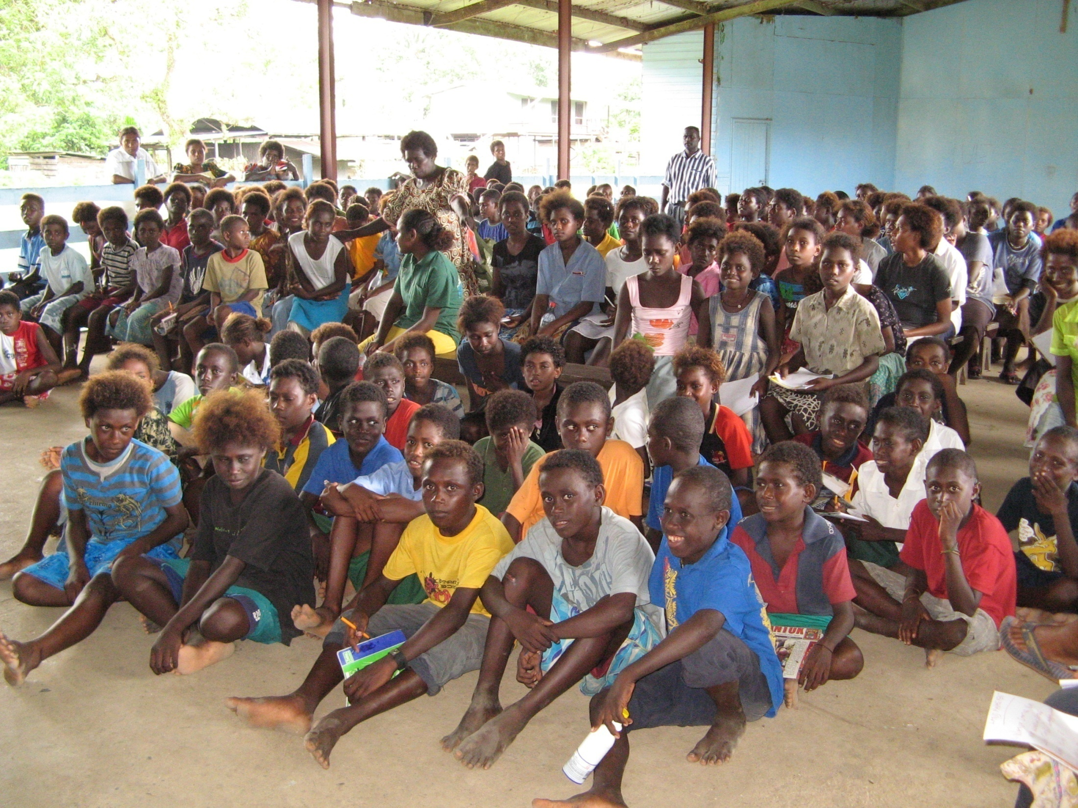
HWC campaigns are well attended and often overcrowded by surprise whole school additions!

Slide 21
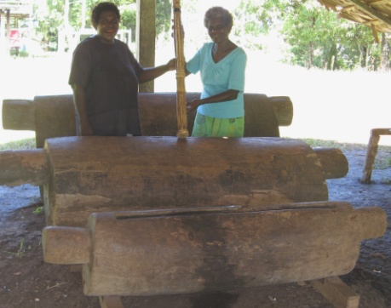
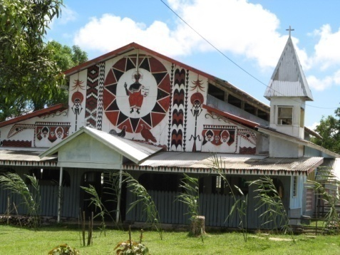
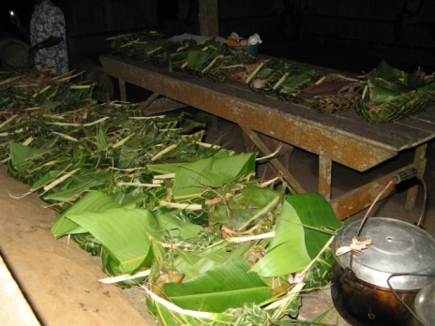
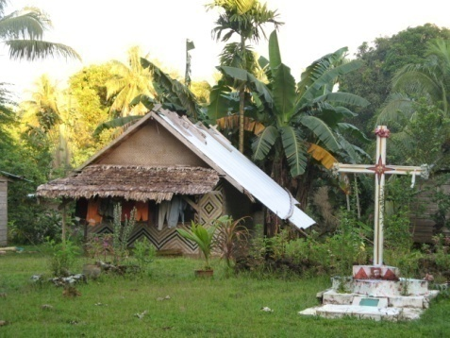
CHALLENGES IN HAKU
-Lack of access to fresh water – urgent need for tanks since ‘el nino 2011’
-Logging for reconstruction of villages post crisis & commercial gain
-Land clearing & forest felling for traditional garden methods
-Land shortage due to overpopulation & CONFLICT over land
- Biodiversity under threat and the disappearance of traditional greens & protein foods
- Over fishing of reefs destroying fish breeding,
- Overharvesting of marine life & coral bleaching
- Community ignorance and resistance to urgent need to change harmful practices in bush, reef & sea management
- Limited resources to impact our HWC advocacy talks, projects, & skills training to enhance village cooperation
- Cultural burdens - Hako community cultural activities & feasts; hard physical labour & obligations with continual debts mounting across families & clans
- Lack of political implementation and finance towards environmental issues
- Need for more women decision makers at policy levels; gender equity issues

Slide 22
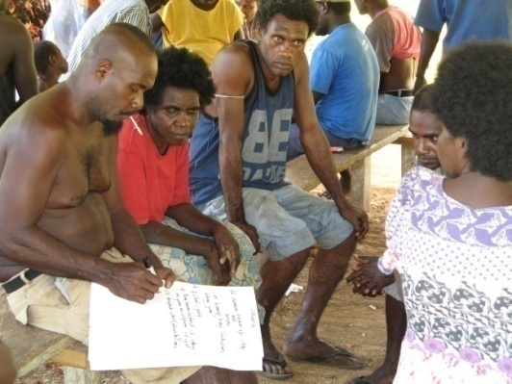
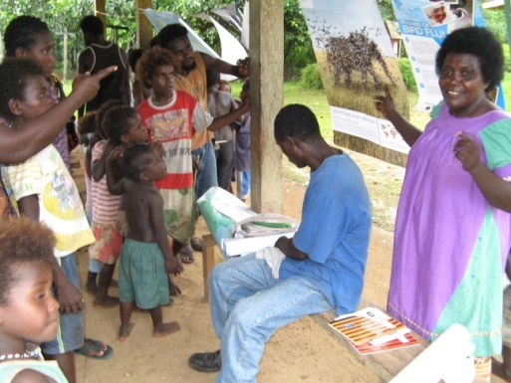
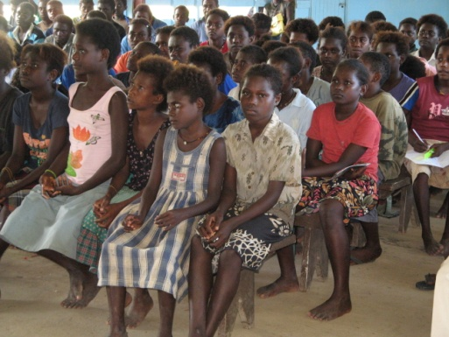
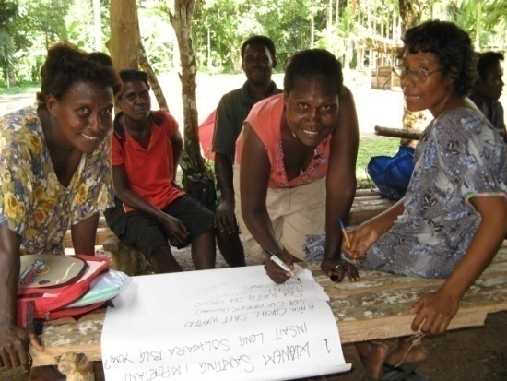
Village to Village Visits
Recording-writing essential to project , Venues- variable: Tsuhanas, shade trees, halls
Visual documenting - photographs, video Transport- variable, unreliable
Exciting follow up possibilities How to be Inspirational/creative positive
for Research , Evaluations, Preparation of presentations & discussions
Special attributes Challenges
- Unity of all women’s groups - Languages x 3 (Pidgin & Hako & English)
-All agreed on purpose - Cultural & clan differences/sensitivities
- Care & commitment to community - Increased feeling of responsibility – be brave!
-Teams are gender & age inclusive - HWC is always having to ‘prove ourselves’
-Many communities welcome HWC - To find continued funding for future
- Capacity of teams has increased - Need more practical & technical resources
- True Interest, sharing, & Community development approach is working
Village Visits: things to consider

Slide 23
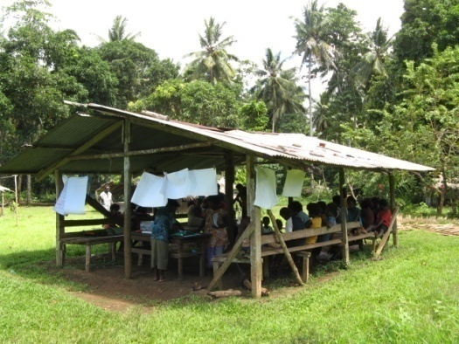
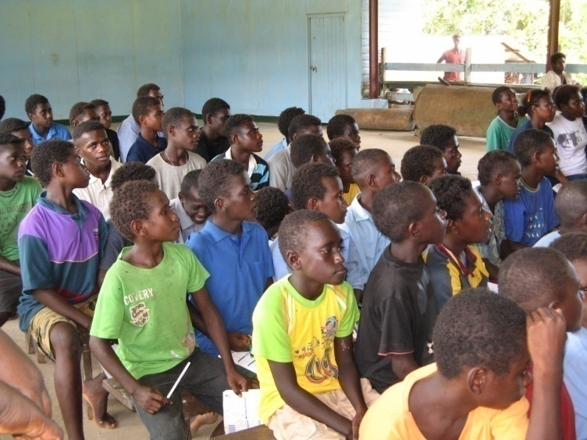
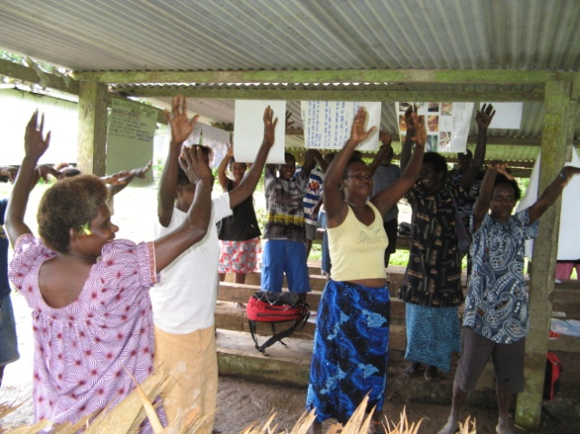
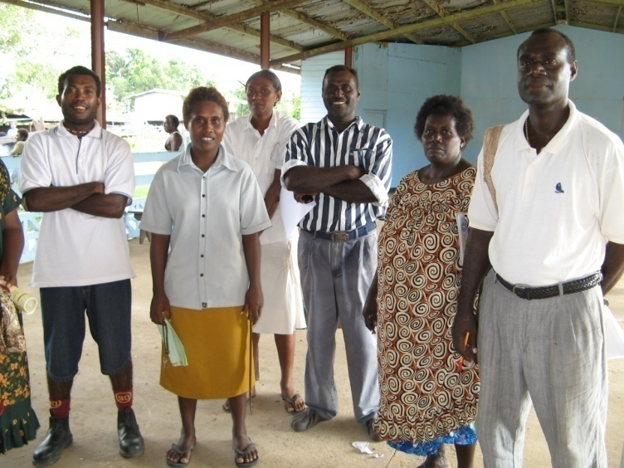
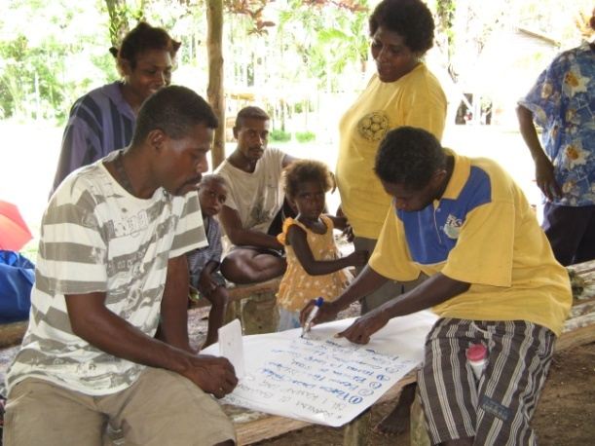
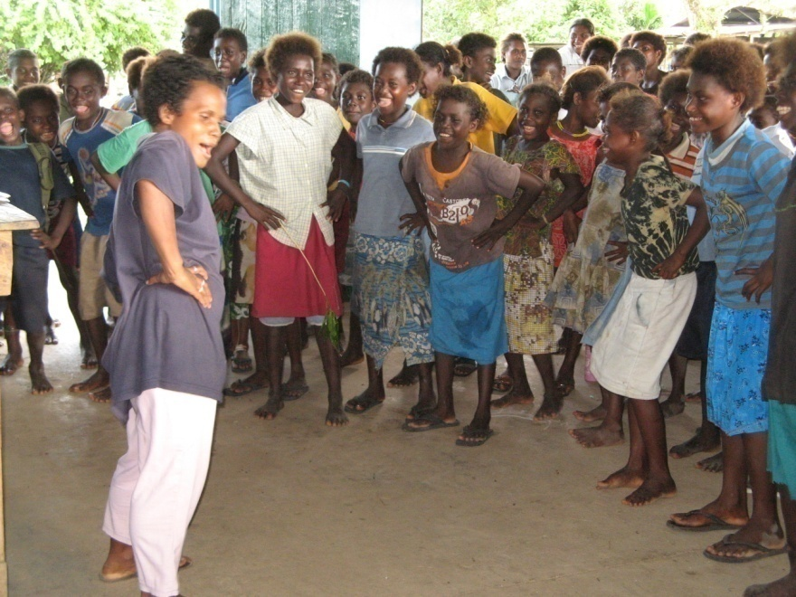
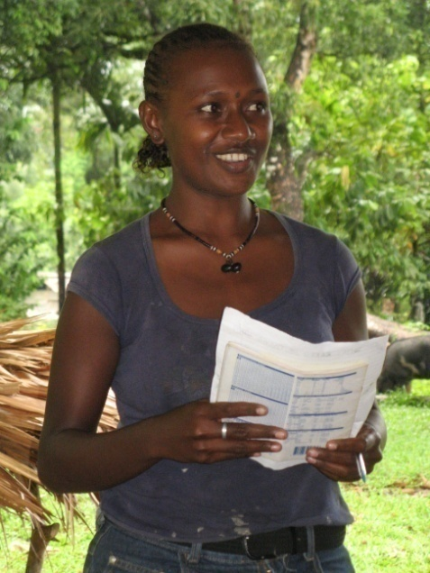
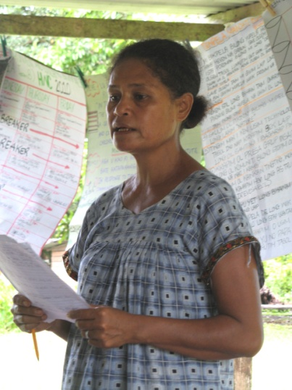
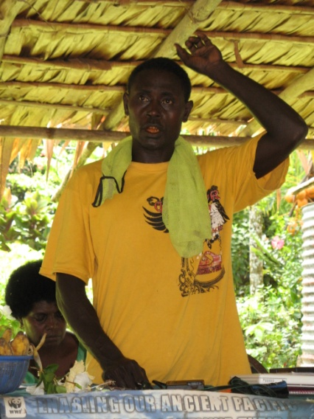
Village visits
Village Visits

Slide 24
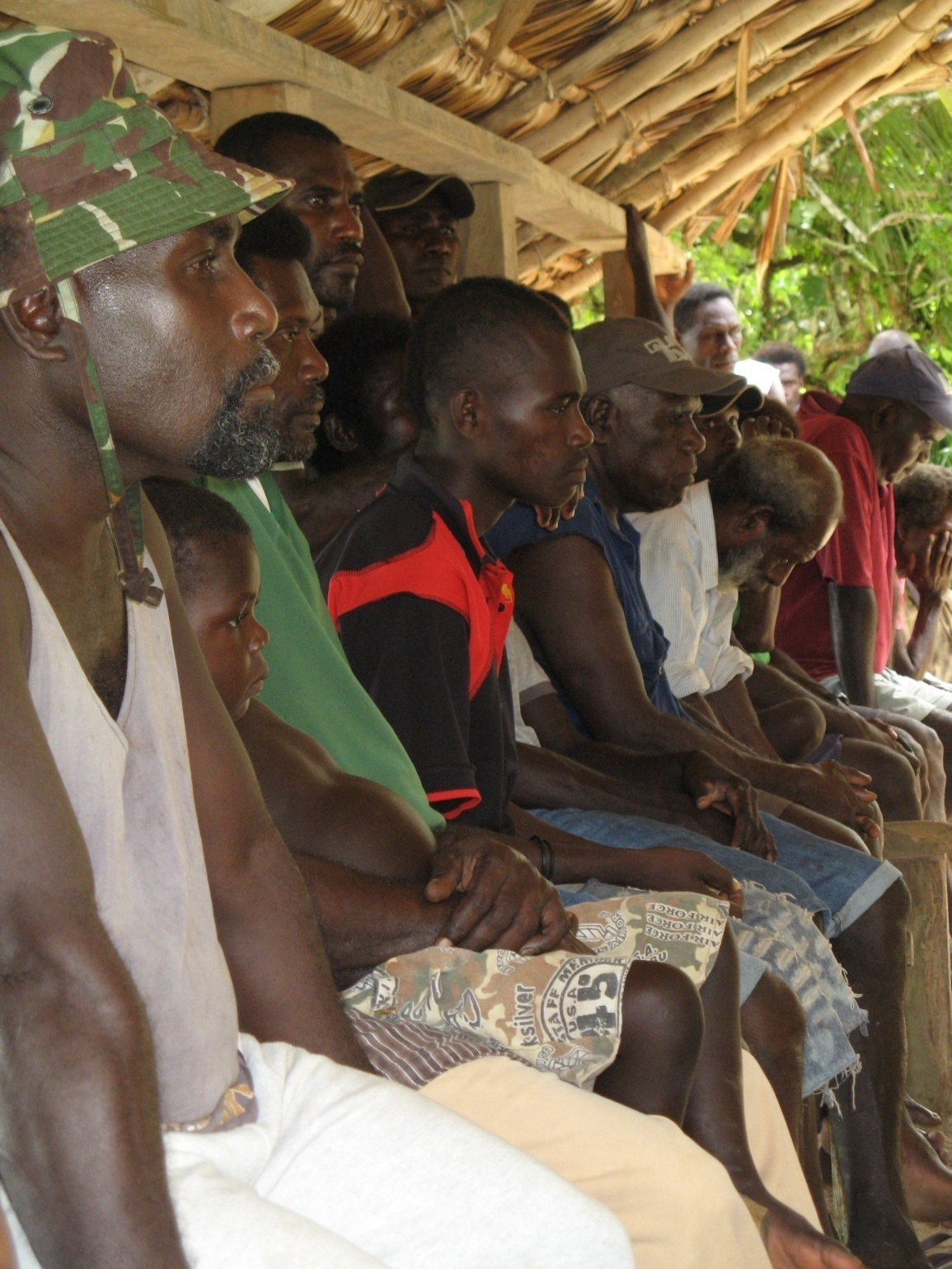
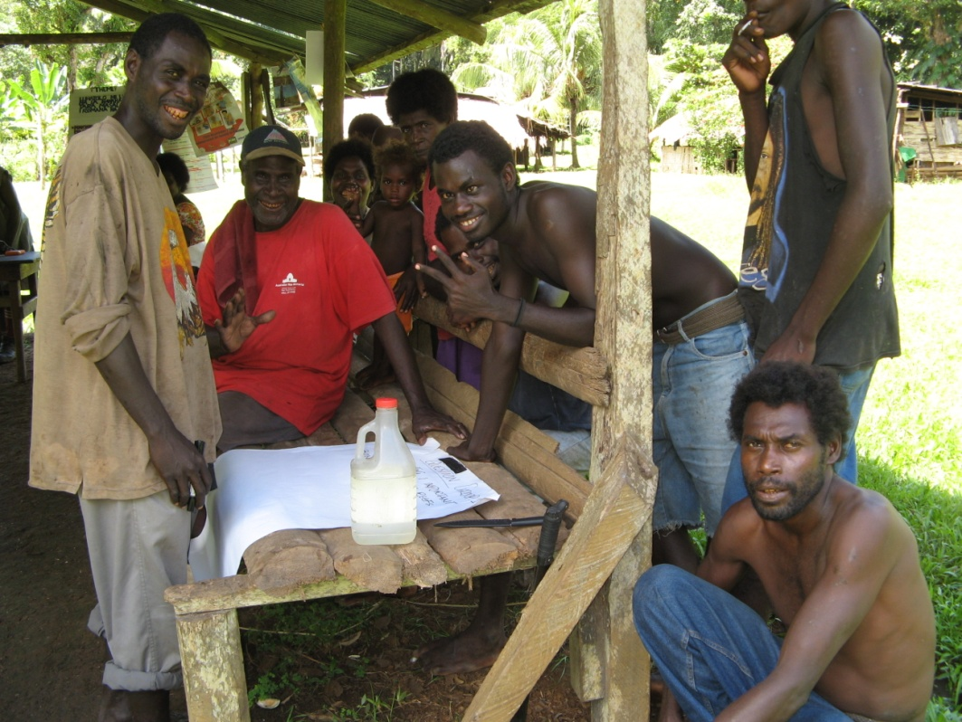
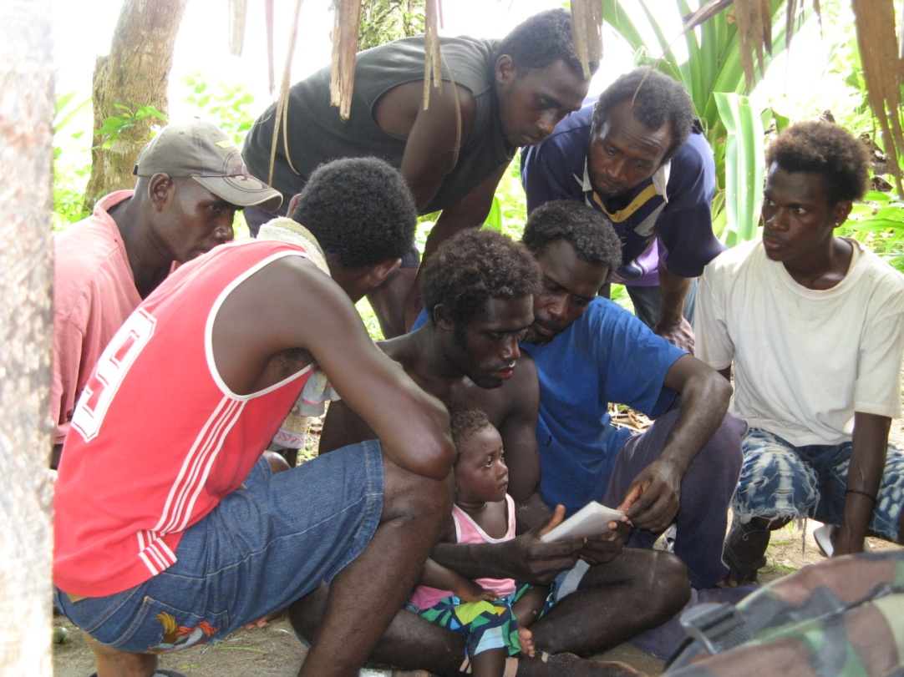

Slide 25
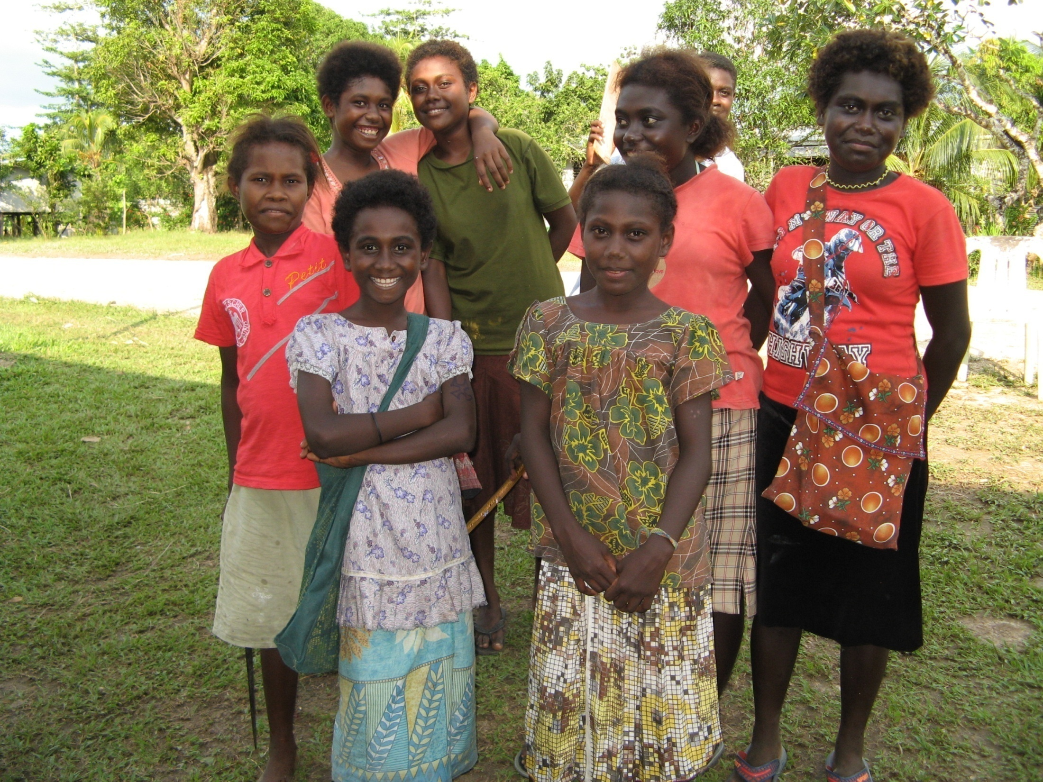

Slide 26
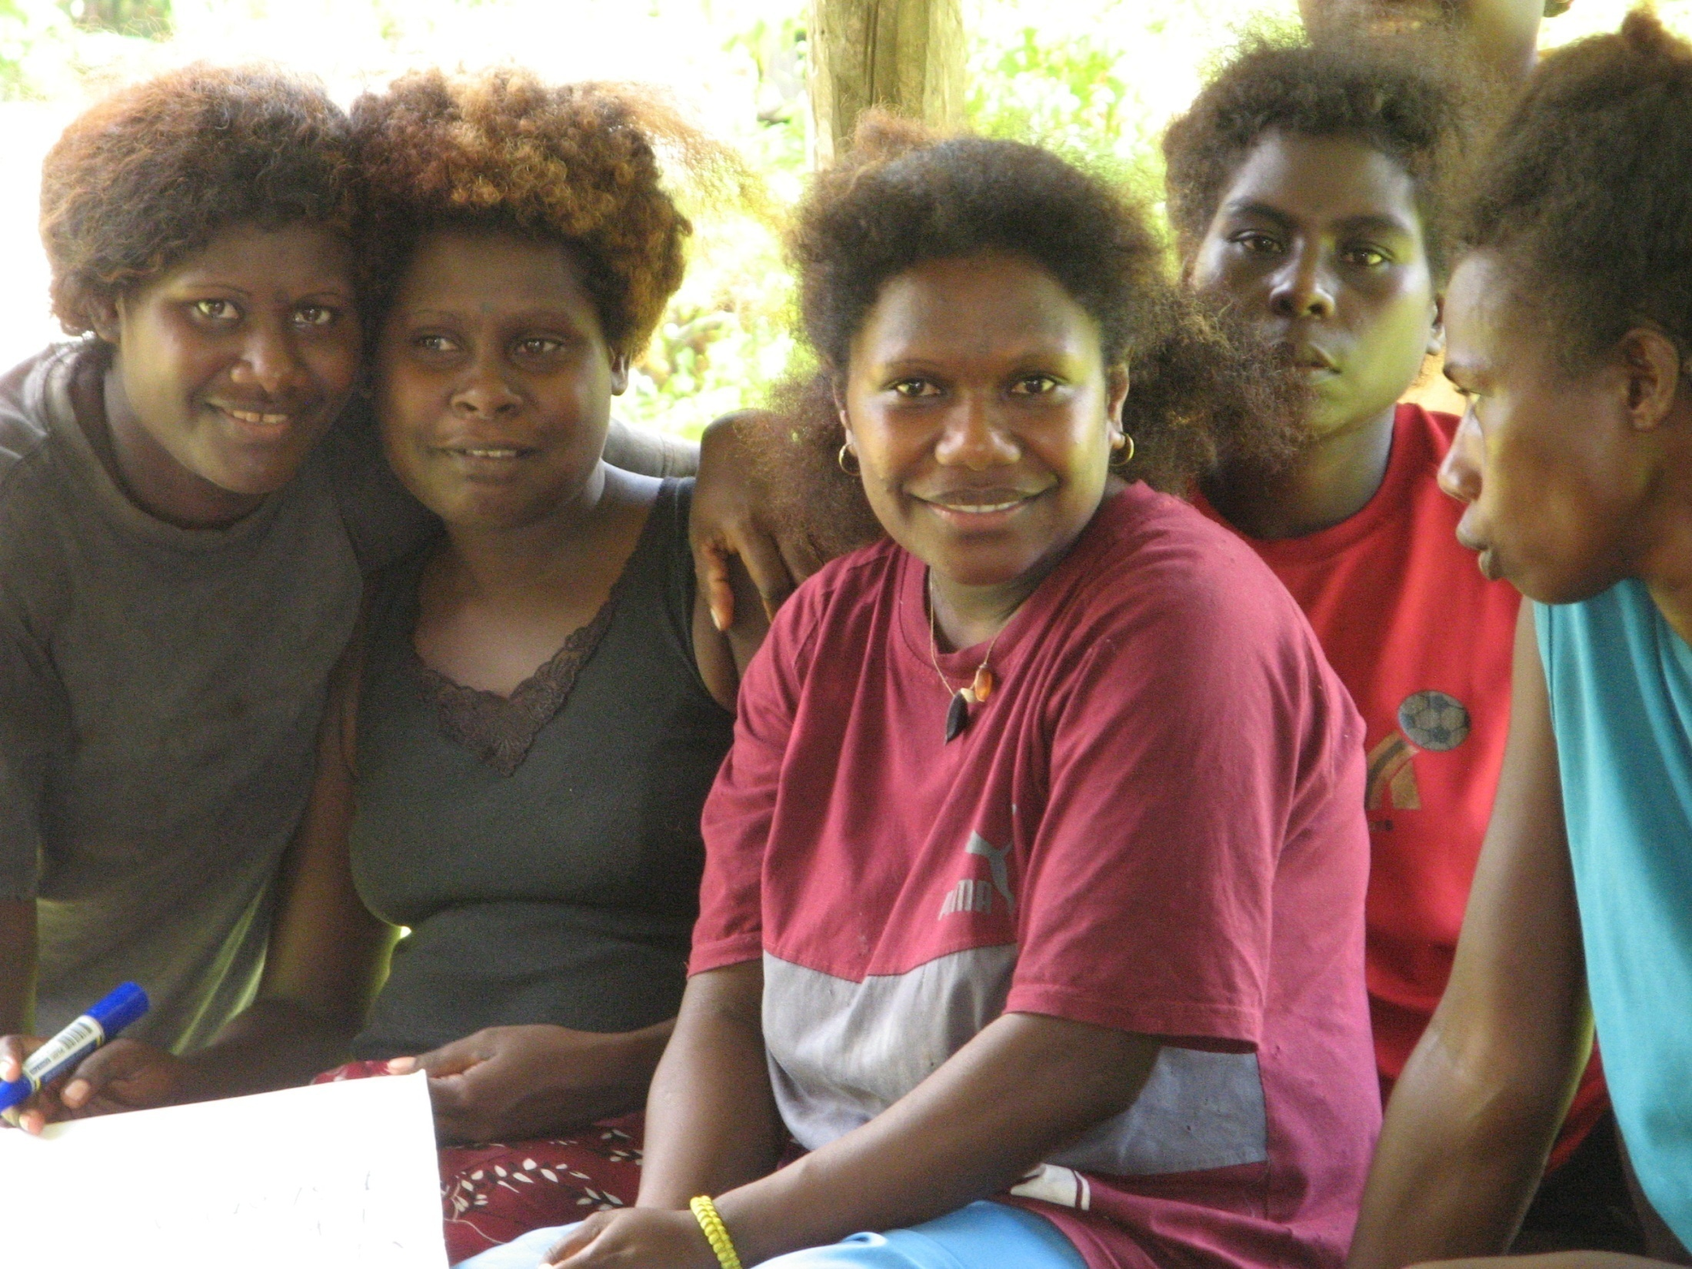

Slide 27
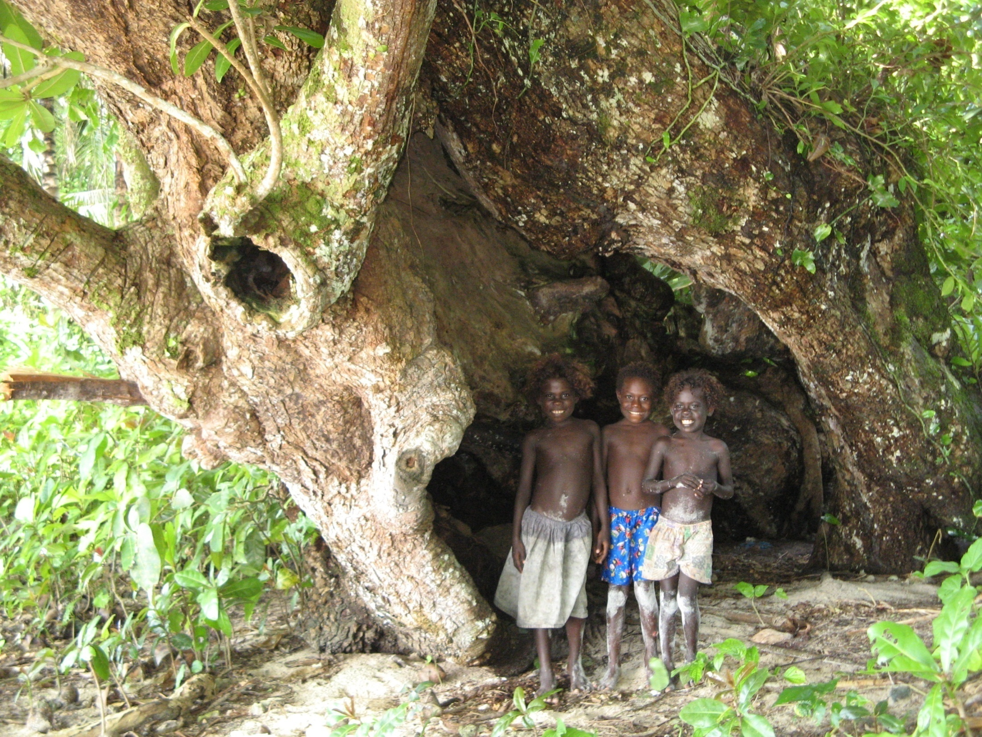

Slide 28
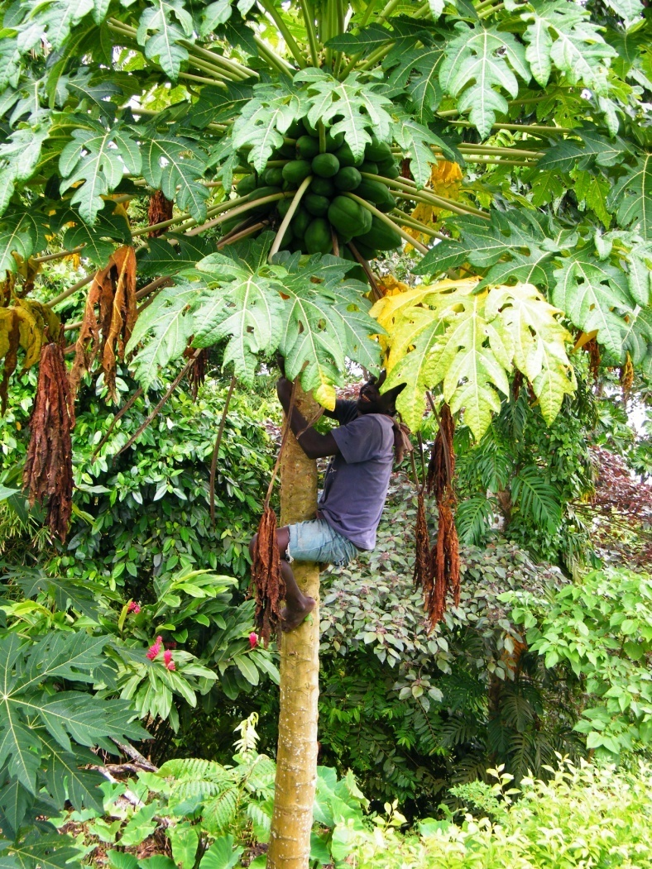
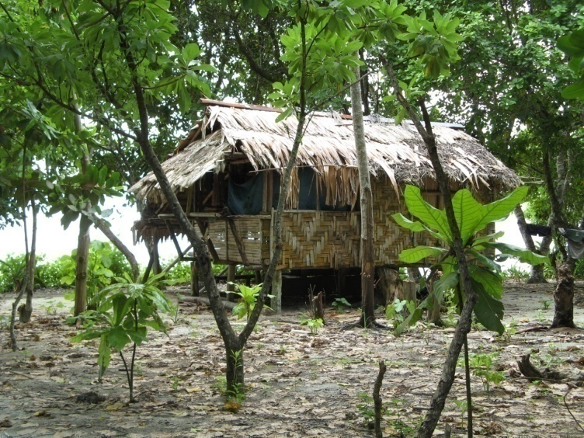
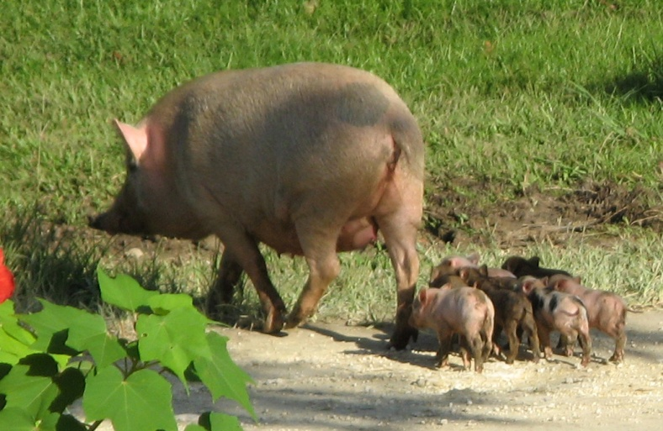
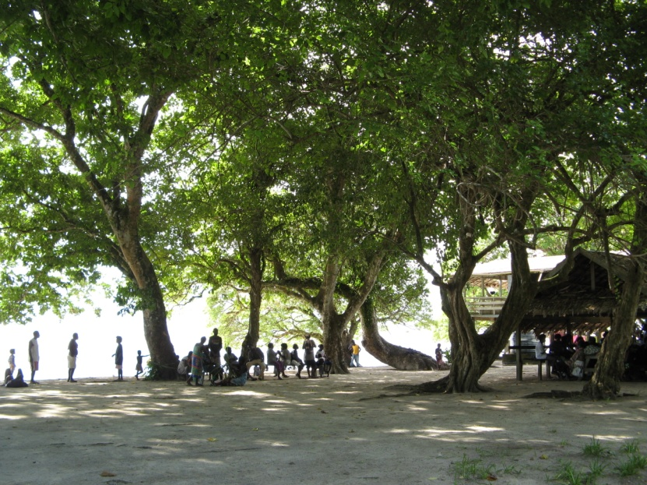
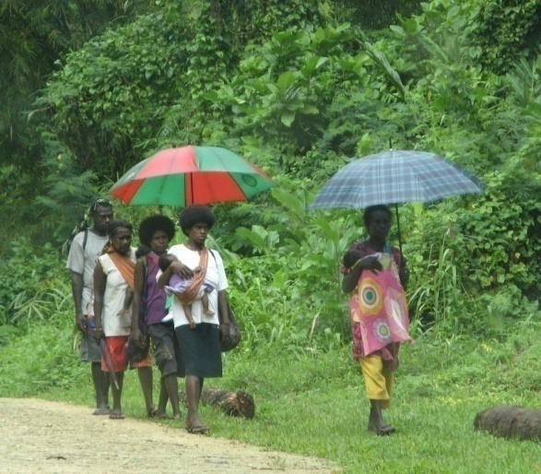
Village Scenes In Hako
Notes:
The men here are pounding copra, one of their cash crops, the young man up the tree is gathering pawpaws. The pig and piglets are typical roaming freely around the villages. These are beach villages and women on their way to a clinic with their babies.

Slide 29
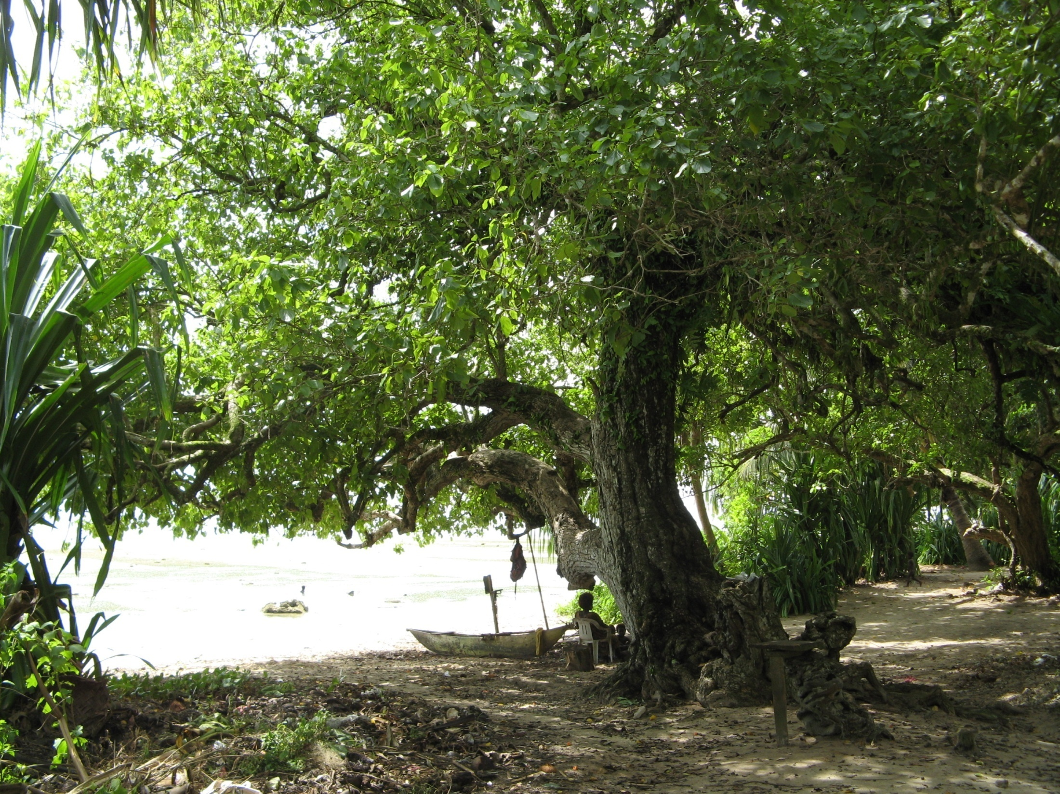

Slide 30
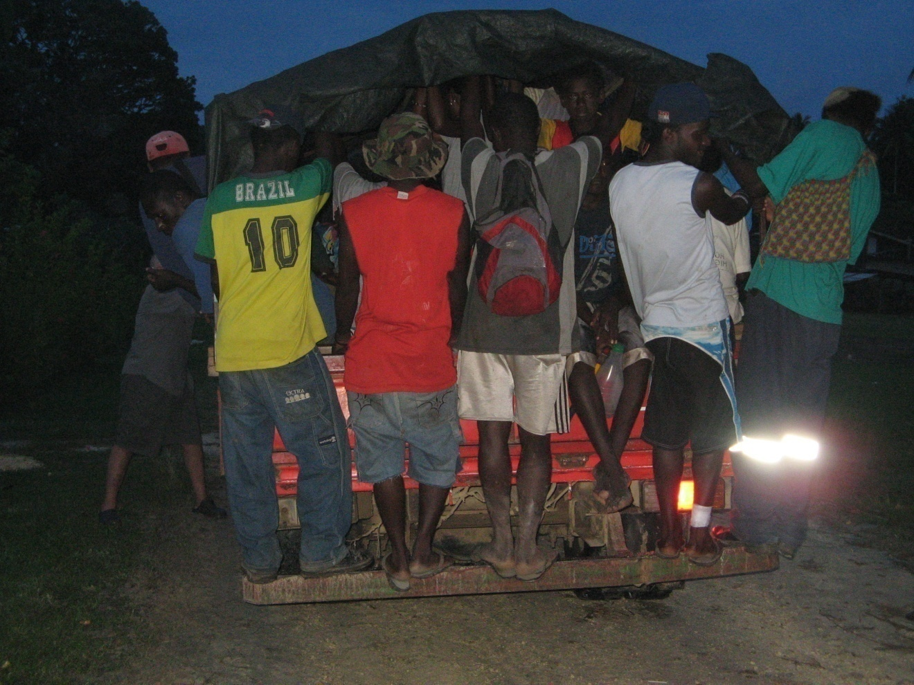
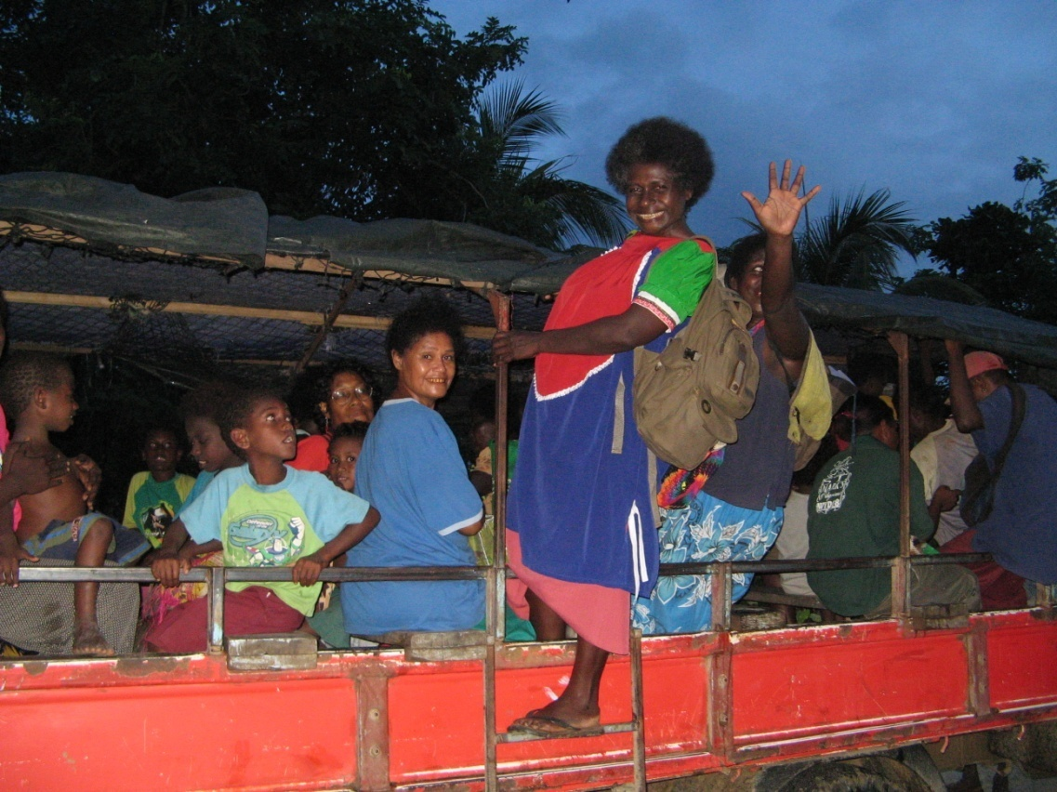
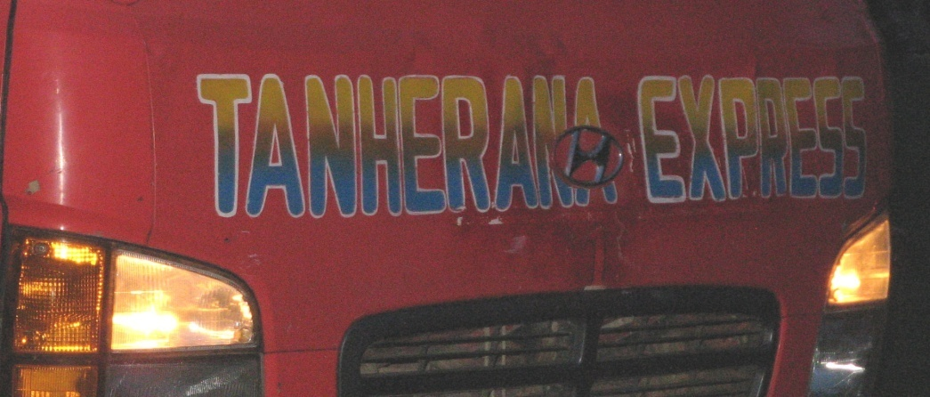
Transport Options
Notes:
Overloaded PMVs are the ‘ships of the jungle’. They cost our HWC PNGKina 600.00 per day hire and are meant to carry no more than 30 passengers. They are often overloaded to carry 50-60. Sometimes the boys sit on the roof but it is more common for them to hang onto the flimsy back rails as shown here. We only have one road in Hako – often the PMVs get bogged as the crushed coral roads are often in extremely poor 4WD conditions. All the PMV leave Hako 6am for town and don’t return until early evening. Unless we hire to run our programs, we walk for hours to reach our village destinations.

Slide 31
Notes:
Outrigger canoes are the more traditional means for off shore and reef fishing. They are carved with more modern tools than stone axes but they are still corked with traditional resins. Some people burn blue plastic supermarket bags to seal the holes. This is unfriendly practice to the environment. The increasingly common practice of dripping burnt plastic onto cooking fires as ‘fire starters’ is hard to stop – but we are trying in our awareness campaigns.

Slide 32
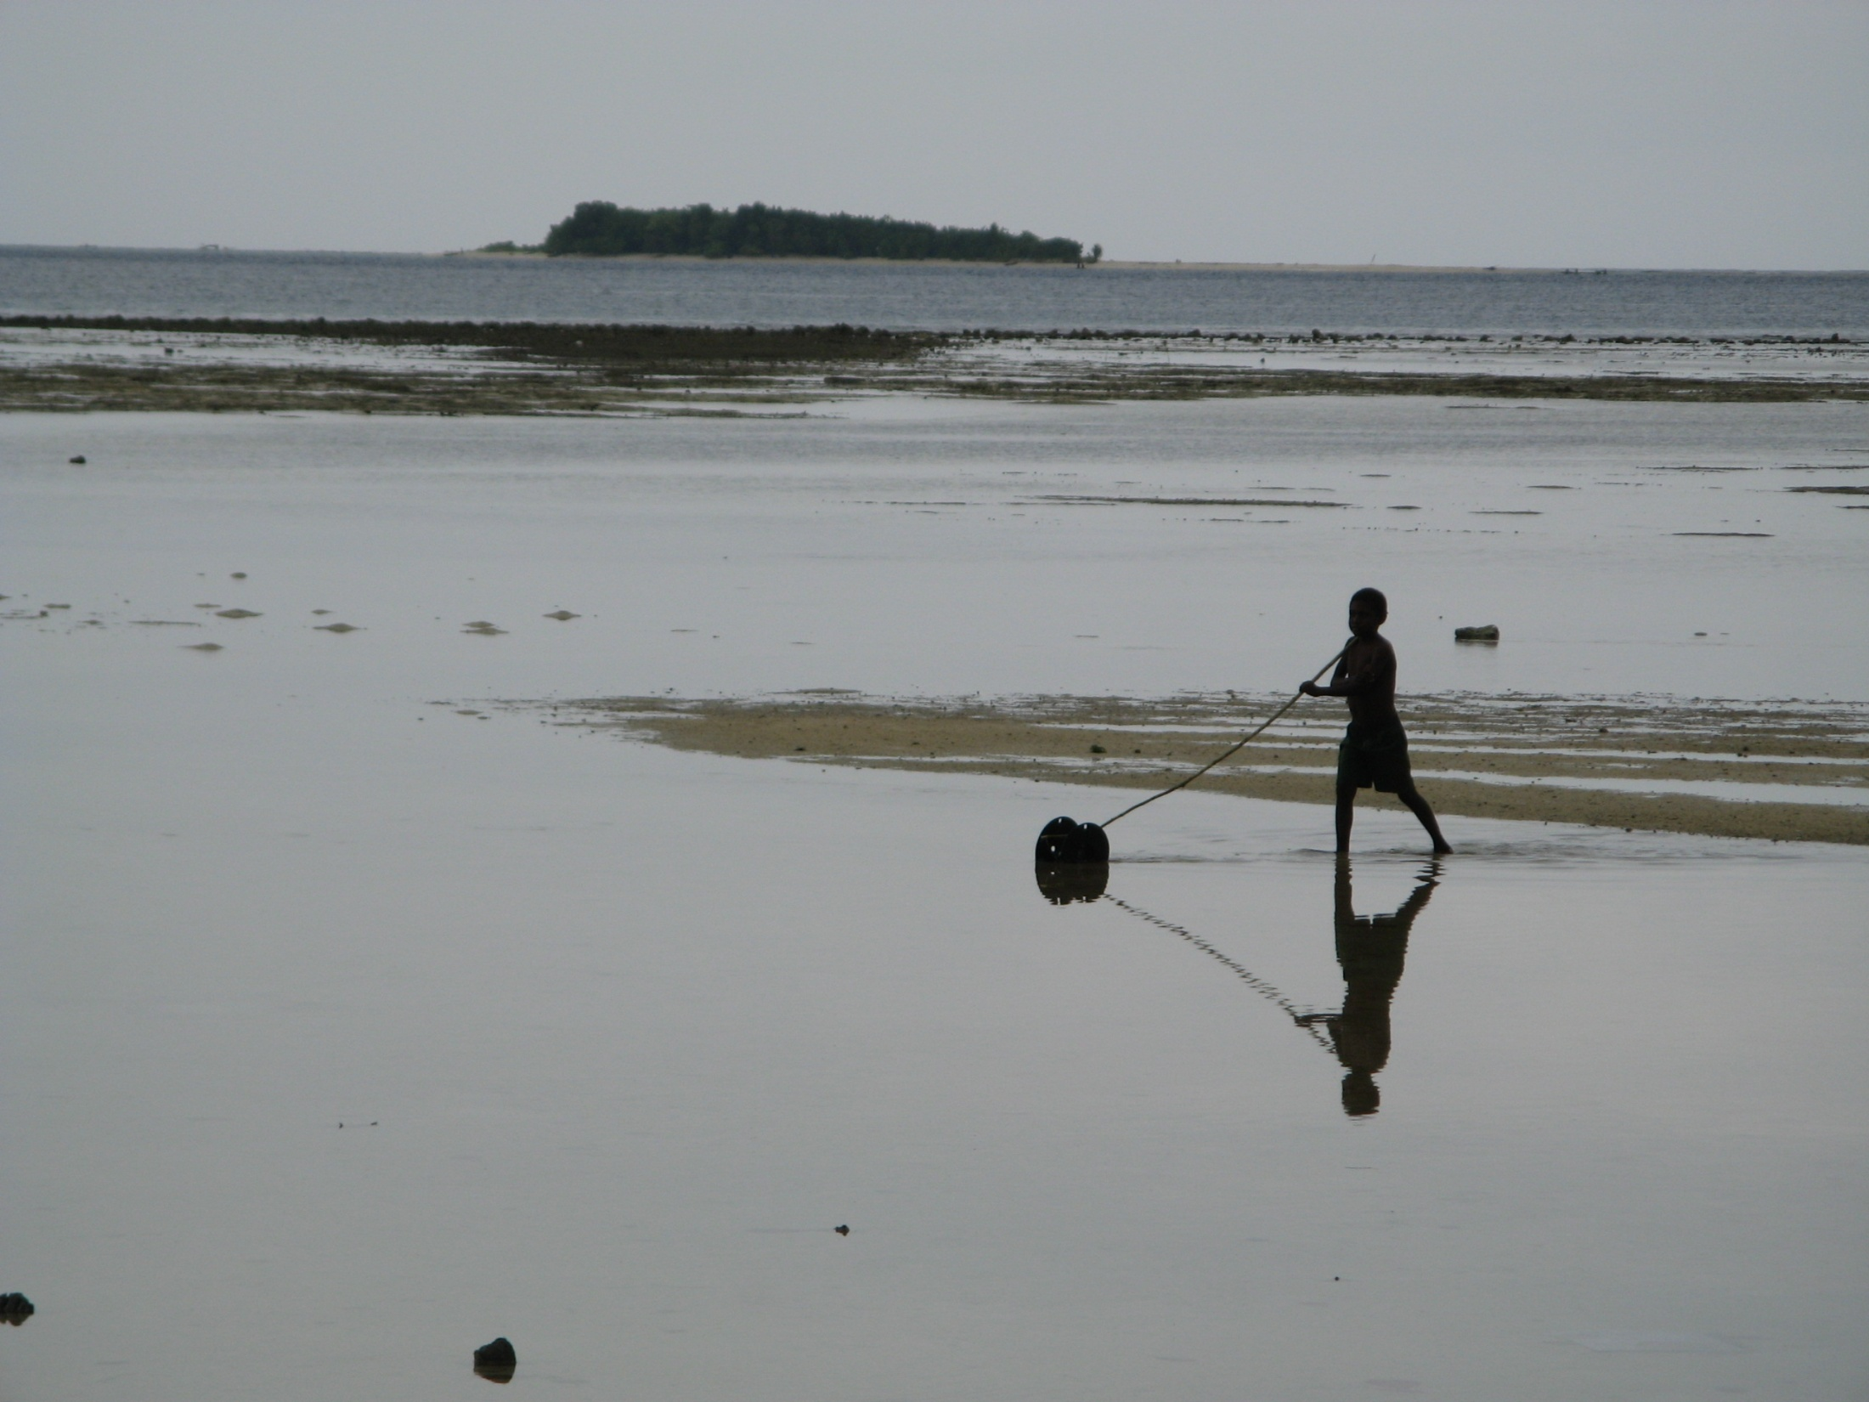

Slide 34
